Slide 1
Selected topics in solid state physics
Rososhek Alexander
Preparatory material for the 4mh laboratory

Slide 2

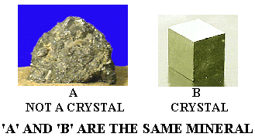
Classification of solids
SOLID MATERIALS
CRYSTALLINE
POLYCRYSTALLINE
AMORPHOUS
(Non-crystalline)
Single Crystal

Slide 3
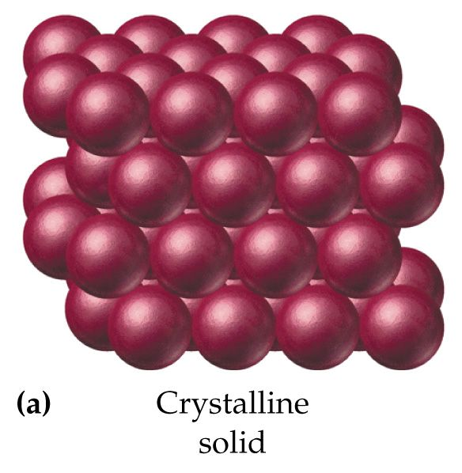
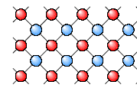
Crystalline solid
Crystalline Solid is the solid form of a substance in which the atoms or molecules are arranged in a definite, repeating pattern in three dimension.

Slide 4
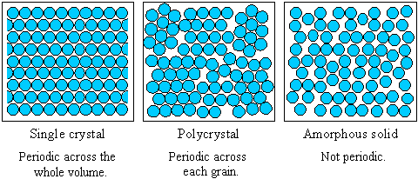
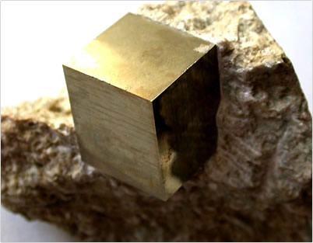
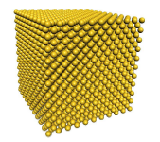
Crystalline solid
Single crystal has an atomic structure that repeats periodically across its whole volume. Even at infinite length scales, each atom is related to every other equivalent atom in the structure by translational symmetry
Single Pyrite
Crystal
Amorphous
Solid
Single Crystal

Slide 5
Energy levels in a crystalline solid
Every cubic cm contains about 10²² atoms; therefore, in ordered crystal every single-atom energy level is divided into 10²² different very dense levels. Hence, one might think of these levels as energy bands. In between every energy band there is an energy gap which contains forbidden energy levels.
E
Single atom
E
crystal
Valence band, conduction band, and energy gap are important for the electrical conduction.
0
0
Conduction band
E_{ex2}
E_{ex2}
Conductance band
E_{ex1}
E_{ex1}
Energy gap
E_{V}
X 10²²
E_{V}
Eg (gap)
Valence band
E₂
E₂
E₁
E₁

Slide 6
Semiconductors: electrons and holes
At 0K the valence band is full and conduction band empty - like Insulator.
When enough energy is supplied to the e⁻ sitting at the top of the valence band, e⁻ can make a transition to the bottom of the conduction band.
When electron makes such a transition it leaves behind a missing electron state.
This missing electron state is called as a hole.
Hole behaves as a positive charge carrier.
Magnitude of its charge is the same as that of the electron, but with an opposite sign.
Empty
conduction
band
Forbidden
energy gap [Eg]
e⁻
e⁻
e⁻
e⁻
energy
+
+
+
+
Full
valance
band

Slide 7
Semiconductors: how to excite an electron?
Thermal energy
Electrical field
Electromagnetic radiation
Partially filled
CB
Eg
Partially filled
VB
Energy band diagram of a
s/c at a finite temperature.

Slide 8
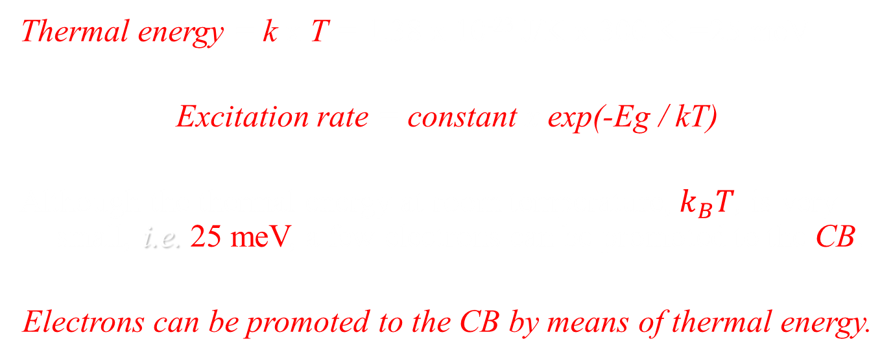
1 - Thermal energy
Thermal energy = k x T = 1.38 x 10⁻²³ J/K x 300 K =25 meV
Excitation rate = constant x exp(-Eg / kT)
Although the thermal energy at room temperature, $k_{B}T$, is very small, i.e. 25 meV, a few electrons can be promoted to the CB.
Electrons can be promoted to the CB by means of thermal energy.
This is due to the exponential increase of excitation rate with increasing temperature.
Excitation rate is a strong function of the temperature.

Slide 9
2 - Electric field
For low fields, this mechanism doesn’t promote electrons to the CB in common s/c’s such as Si and GaAs.
An electric field of 10¹⁸ V/m can provide an energy of the order of 1 eV. This field is enormous.
The use of the electric field as an excitation mechanism is not useful way to promote electrons in s/c’s.

Slide 10
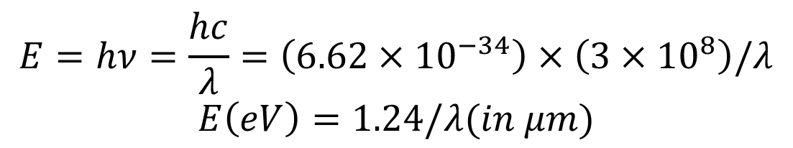
3 - Electromagnetic radiation
h = 6.62 x 10⁻³⁴ J/s
c = 3 x 10⁸ m/s
1 eV=1.6x10⁻¹⁹ J
$$E=hν=\frac{hc}{λ}=\left(6.62×{10}^{−34}\right)×\left(3×{10}^{8}\right)/λ$$
$$E\left(eV\right)=1.24/λ(in μm)$$
Near
infrared
To promote electrons from VB to CB Silicon , the wavelength
of the photons must 1.1 μm or less

Slide 11
3 - Electromagnetic radiation
The converse transition can also happen.
An electron in CB recombines with a hole in VB and generate a photon.
The energy of the photon will be in the order of E_{g}.
If this happens in a direct band-gap s/c, it forms the basis of LED’s and LASERS.
Conduction Band
e⁻
photon
+
Valence Band

Slide 12
Intrinsic semiconductor
The conductivity of a pure (intrinsic) s/c is low due to the low number of free carriers.
The number of carriers are generated by thermally or electromagnetic radiation for a pure s/c.
For an intrinsic semiconductor
n = p = n_{i}
n = concentration of electrons per unit volume
p = concentration of holes per unit volume
n_{i} = the intrinsic carrier concentration of the semiconductor under consideration.

Slide 13
Intrinsic semiconductor
The intrinsic carrier concentration n_{i} depends on;
the semiconductor material
the temperature.
For silicon at 300 K, n_{i} has a value of 1.4 x 10¹⁰ cm^{-3.}
Clearly , equation (n = p = n_{i}) can be written as
n.p = n_{i}²

Slide 14
What is doping and dopant impurities ?
Donors and acceptors (extrinsic semiconductors)
To increase the conductivity, one can dope pure s/c with atoms from column III (starts with B) or V (starts with N) of the periodic table. This process is called doping and the added atoms are called dopant impurities.
n (negative) - type
p (positive) - type
Addition of different atoms modify the conductivity of the intrinsic semiconductor.

Slide 15
p-type doped semiconductor
Boron atoms have three valence electrons, there is a deficiency of electron or missing electron to complete the outer shell.
Each added or doped boron atom introduces a single hole to the crystal.
There are two ways of producing a hole
1) Promote e⁻’s from VB to CB;
2) Add column III impurities to the s/c.

Slide 16
p-type energy diagram
CB
E_{c} = CB edge energy level
acceptor
(Column lll) atoms
E_{g}
E_{A}= Acceptor energy level
E_{v} = VB edge energy level
VB
Electron
Hole

Slide 17
p-type doped semiconductor
The impurity atoms from column III occupy at an energy level within E_{g} . These levels can be
Shallow levels which are close to the band edge,
Deep levels which lie almost at the middle of a band gap.
If the E_{A} level is shallow i.e. close to the VB edge, each added boron atom accepts an e⁻ from VB and have a full configuration of e⁻’s at the outer shell.
These atoms are called as acceptor atoms since they accept an e⁻ from VB to complete its bonding. So each acceptor atom gives rise a hole in VB.
The current is mostly due to holes since the number of holes are made greater than e⁻’s.

Slide 18
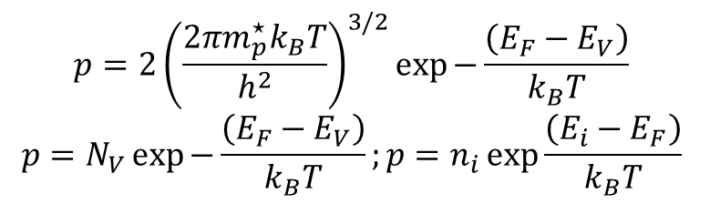
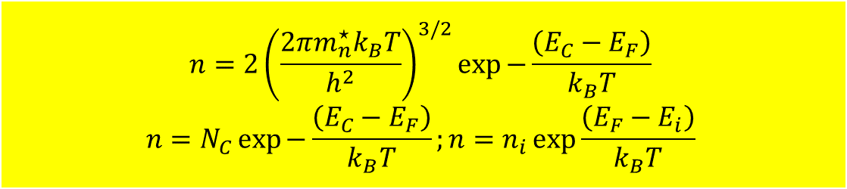
Carrier concentration equations
The number density, i.e., the number of electrons available for conduction in CB is
$$n=2{\left(\frac{2πm_{n}^{⋆}k_{B}T}{h^{2}}\right)}^{3/2}\exp{−\frac{\left(E_{C}−E_{F}\right)}{k_{B}T}}$$
$$n=N_{C}\exp{−\frac{\left(E_{C}−E_{F}\right)}{k_{B}T}};n=n_{i}\exp{\frac{\left(E_{F}−E_{i}\right)}{k_{B}T}}$$
The number density, i.e., the number of holes available for conduction in VB is
$$p=2{\left(\frac{2πm_{p}^{⋆}k_{B}T}{h^{2}}\right)}^{3/2}\exp{−\frac{\left(E_{F}−E_{V}\right)}{k_{B}T}}$$
$$p=N_{V}\exp{−\frac{\left(E_{F}−E_{V}\right)}{k_{B}T}};p=n_{i}\exp{\frac{\left(E_{i}−E_{F}\right)}{k_{B}T}}$$

Slide 19


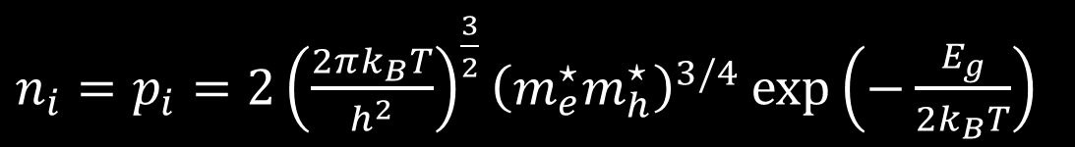
Charge concentration: intrinsic s/c
$n_{i}=p_{i}=2{\left(\frac{2πk_{B}T}{h^{2}}\right)}^{\frac{3}{2}}{\left(m_{e}^{⋆}m_{h}^{⋆}\right)}^{3/4}\exp\left(−\frac{E_{g}}{2k_{B}T}\right)$
$m_{e}^{⋆}$ - effective electron mass
$m_{h}^{⋆}$ - effective hole mass
$E_{g}$ - energy gap between the VB and CB
$T = 300K$ $2(2πmk_{B}T/h^{2})3/2 ≈ {10}^{19}$ per cm³
Example: intrinsic semiconductors at $T=300K$:
n_{i} (Si) ≈ 1.2 x 10¹⁰ cm⁻³
n_{i} (Ge) ≈ 2.4 x 10¹³ cm⁻³
n_{i} (GaAs) ≈ 2.2 x 10⁶ cm⁻³
As you may see these concentrations are significantly lower than the atom number density in a crystal ($∝{10}^{22} cm^{−3}$)

Slide 20
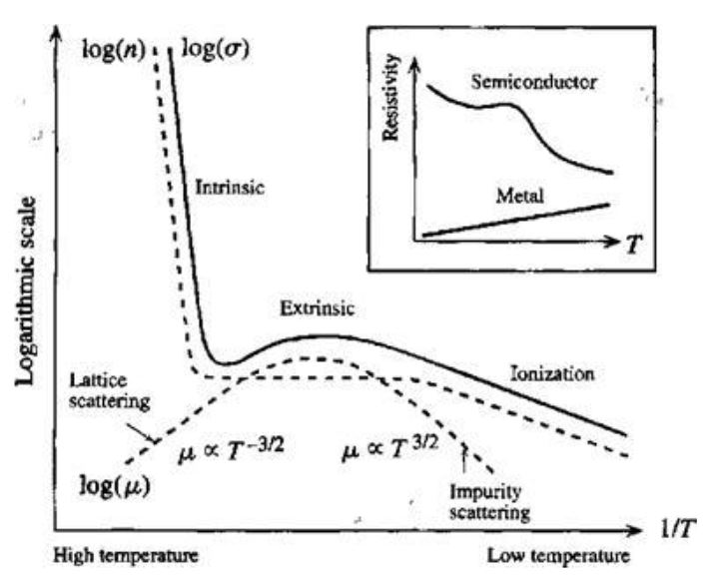
s/c conductivity vs temperature

